Slide 1
HUMAN COMPUTER INTERACTION
UE18CS348
Project Name - Fridge Friend
PROJECT TEAM :
Animeha Bakshi - PES1201801661
Bhavana Madhuri V - PES1201801231
Nipun Bhat - PES1201801857
Rishab Shivkumar - PES1201801034

Slide 2
PROBLEM STATEMENT
Food waste is a specific piece of food loss, which the US Department of Agriculture’s (USDA) Economic Research Service (ERS), defines as food discarded by retailers due to color or appearance and plate waste by consumers.”
An estimated 931 million tonnes of food were wasted globally in 2019 according to a UN report which said that household food waste in India is about 68.7 million tonnes a year.
The main reasons for household food wastage were identified as:
1) Buying in excess
2) Preparation of more food than would be consumed.
3) Poor storage
4) Poor purchase planning and falling for special offers

Slide 3
Here is how fridge friend helps in the food wastage problem:
Fridge Friend is an app which scans your fridge to create a virtual inventory of what items are present and when they were added. The goal is to alert you as food items begin to spoil.
Fridge Friend is also customized to meet dietary preferences and individual needs of each user by generating recipes based on food items in your fridge that are close to getting expired.
People often spend a lot of time thinking over what to make rather than actually making the meal. Fridge Friend therefore minimizes time spent on searching for recipes and deciding recipes to make.

Slide 4
NEED FINDING
Upon studying per capita household food wastage statistics we found that household food wastage was not only a problem in First World Countries, there are many developing and third world countries with high household food wastage, thus signifying the gravity of the problem.
https://www.statista.com/statistics/933059/per-capita-food-waste-of-selected-countries/
In a study performed between the correlation in income levels and household food wastage, it was found that high income households waste the most food followed by middle income households. This section of society also has the highest access to technology and thus Fridge Friend can help reduce food wastage in these sections.
https://iwmsa.co.za/sites/default/files/downloads/11.%20Ramukhwatho%2C%20FR%20et%20al.pdf
Target Audience: Individuals that are responsible for preparing meals, stocking groceries and managing purchased food items for themselves or a household.

Slide 5
CONCEPT VIDEO
In the concept video for our application, Fridge Friend, we show common issues that working individuals face on a daily basis and how Fridge Friend effectively tackles these problems.
https://drive.google.com/file/d/1PqhvJg7Ahk-VcUGbUXQBjkt38TcnJd8Y/view?usp=sharing

Slide 6
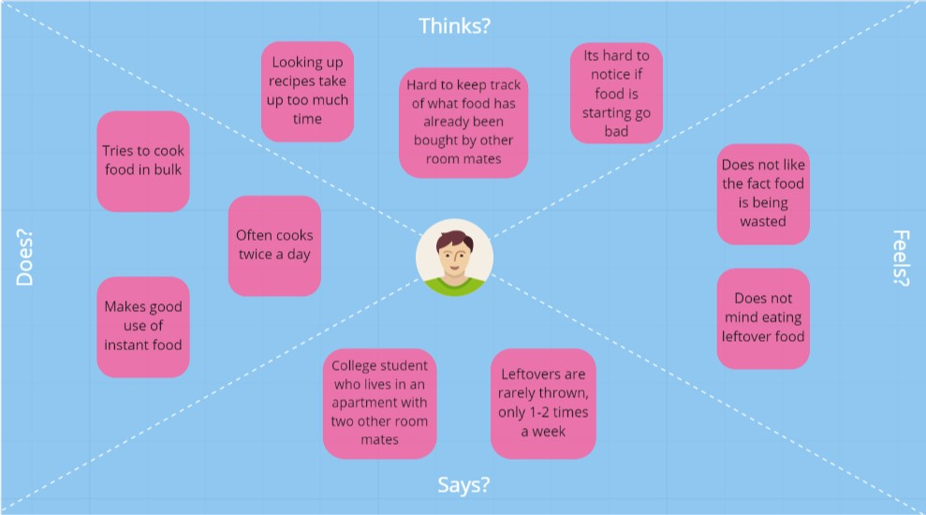
EMPATHY MAP
INTERVIEW 1 :
Ananya: https://drive.google.com/file/d/1rOUxnNC6_Ns3OZLjp7z-4ZVEm4WsBHfF/view?usp=sharing
Questions Asked:
How many times do you cook in a day?
How much time is spent on coming up with a recipe?
What happens to leftovers?
How often do you throw out food because it expired?
How often do you order food

Slide 7
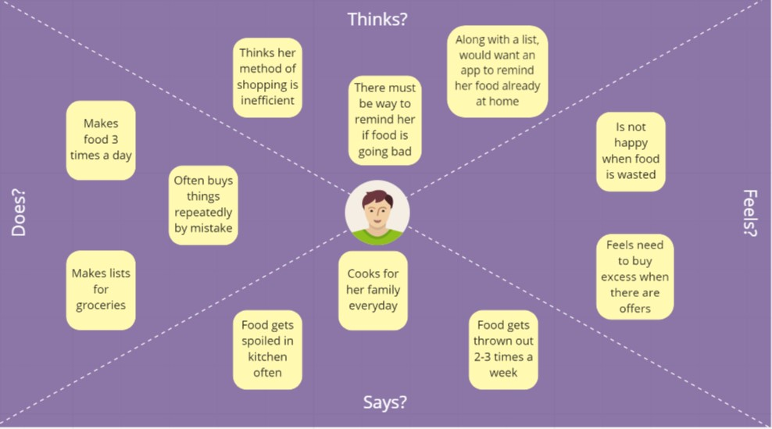
INTERVIEW 2 :
Snigdha Bhat: https://drive.google.com/file/d/1zdZco2VVi1sOCxKfUHI6P_NfhHqD5BSd/view?usp=sharing
Questions Asked:
How many times do you cook food in a day?
How do you plan grocery shopping? Is it effective?
How much food is wasted in a week?
How do you technology helping food wastage?

Slide 8
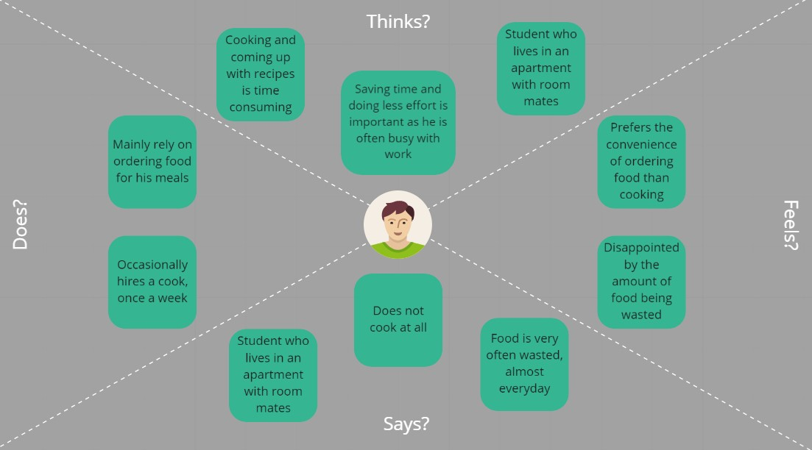
EMPATHY MAP
INTERVIEW 3 :
Siddharth Sunil: https://drive.google.com/file/d/1m7o4zu7aaQtAIlxjlKPqHWC3yAUOQ9GP/view?usp=sharing
Questions Asked:
How many times do you cook in a day?
How much time is spent on coming up with a recipe?
What happens to leftovers?
How often do you throw out food because it expired?
How often do you order food

Slide 9
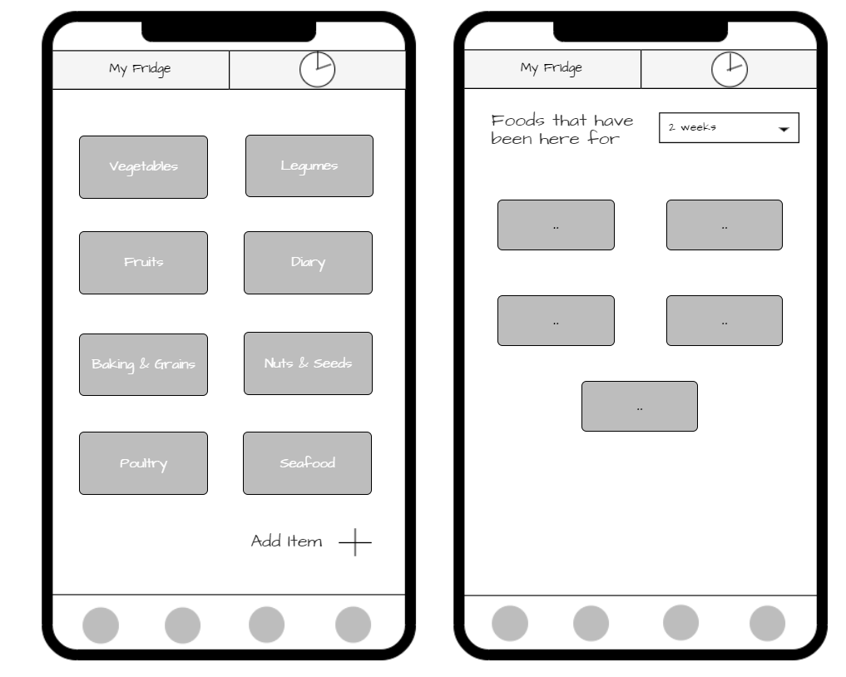
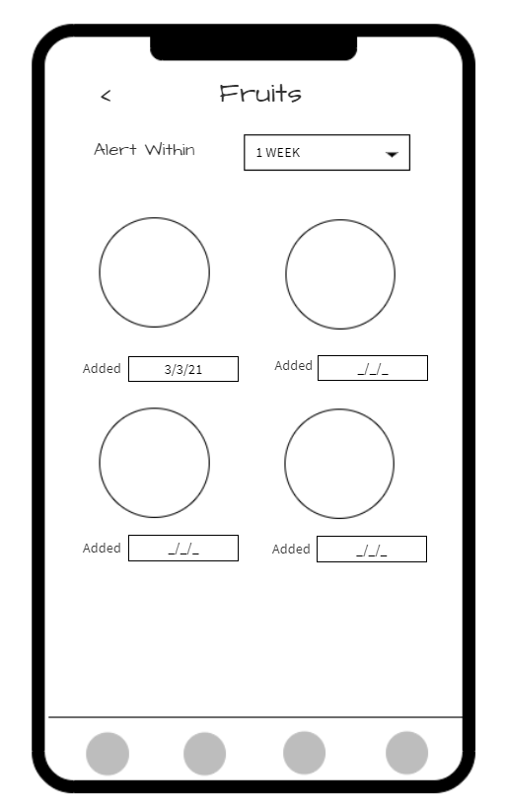
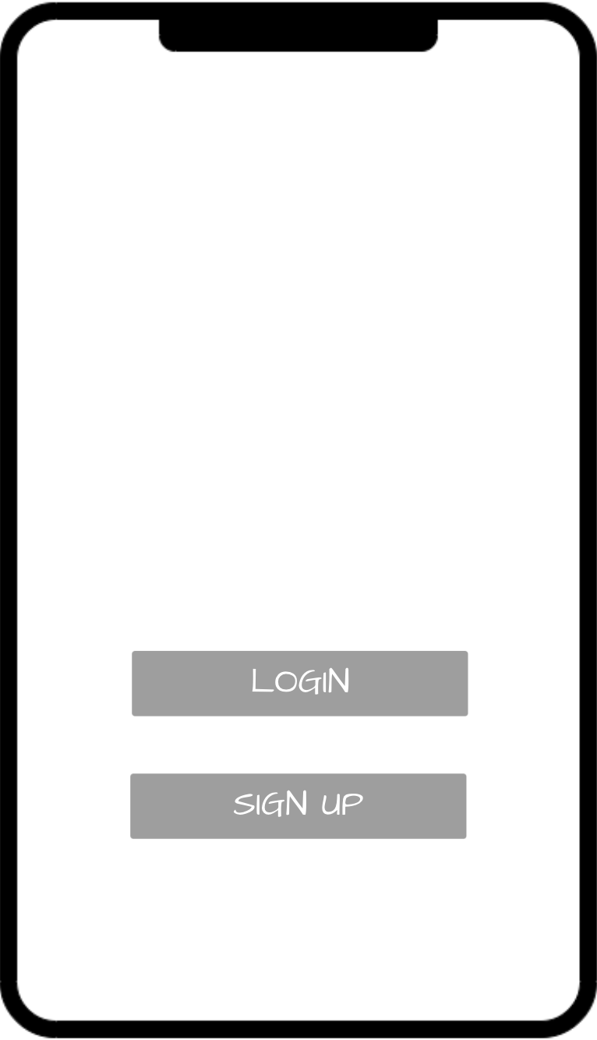
LOW FIDELITY PROTOTYPE

Slide 10
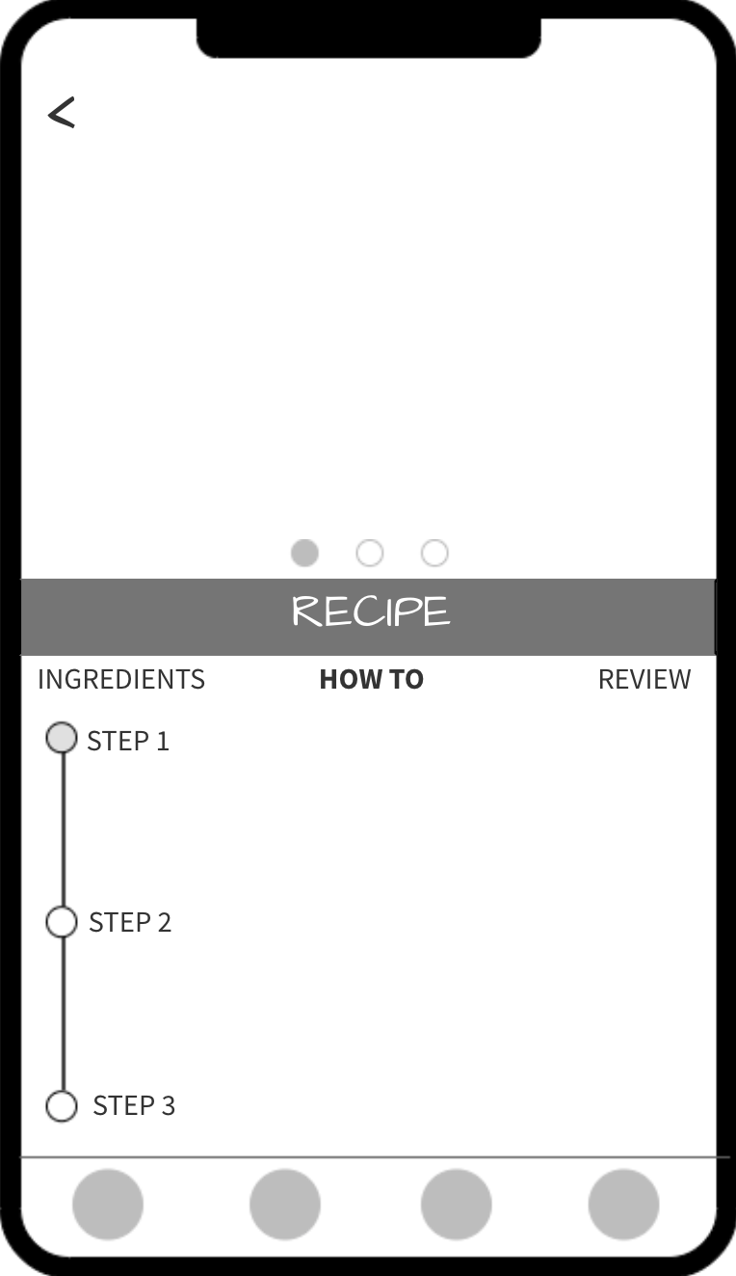
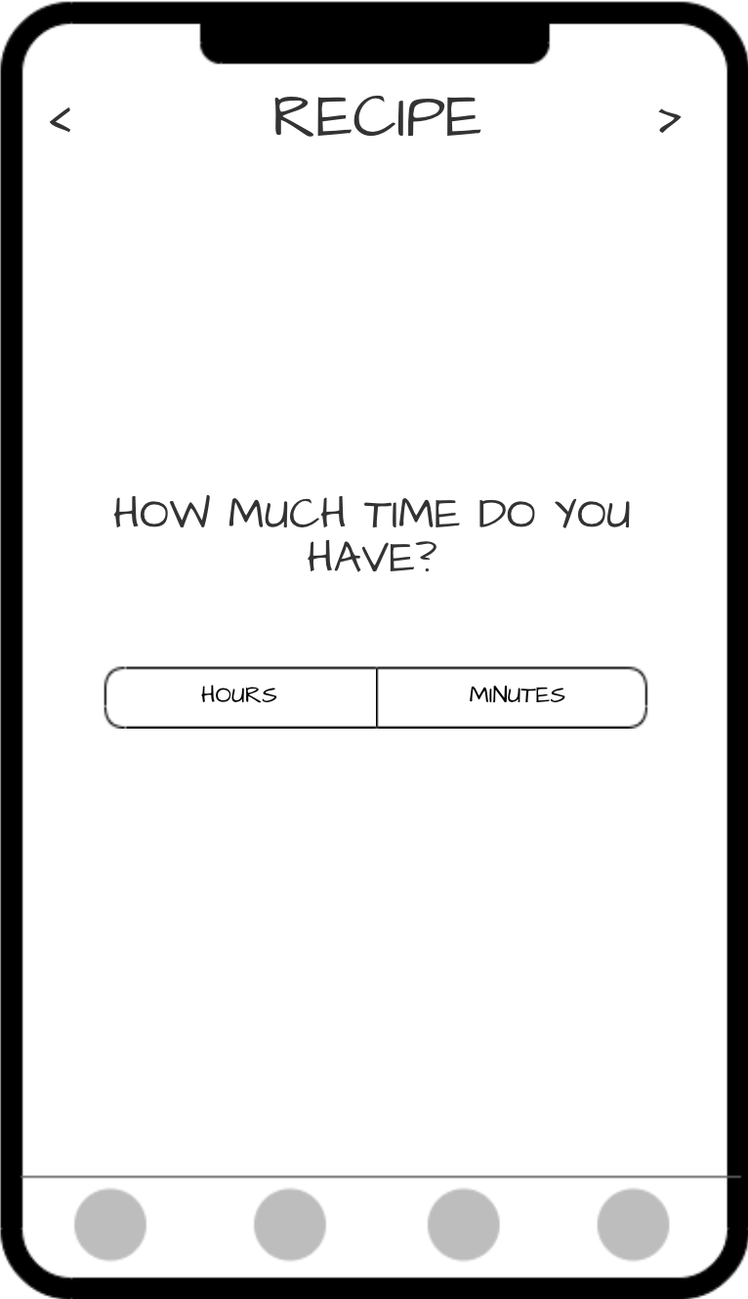
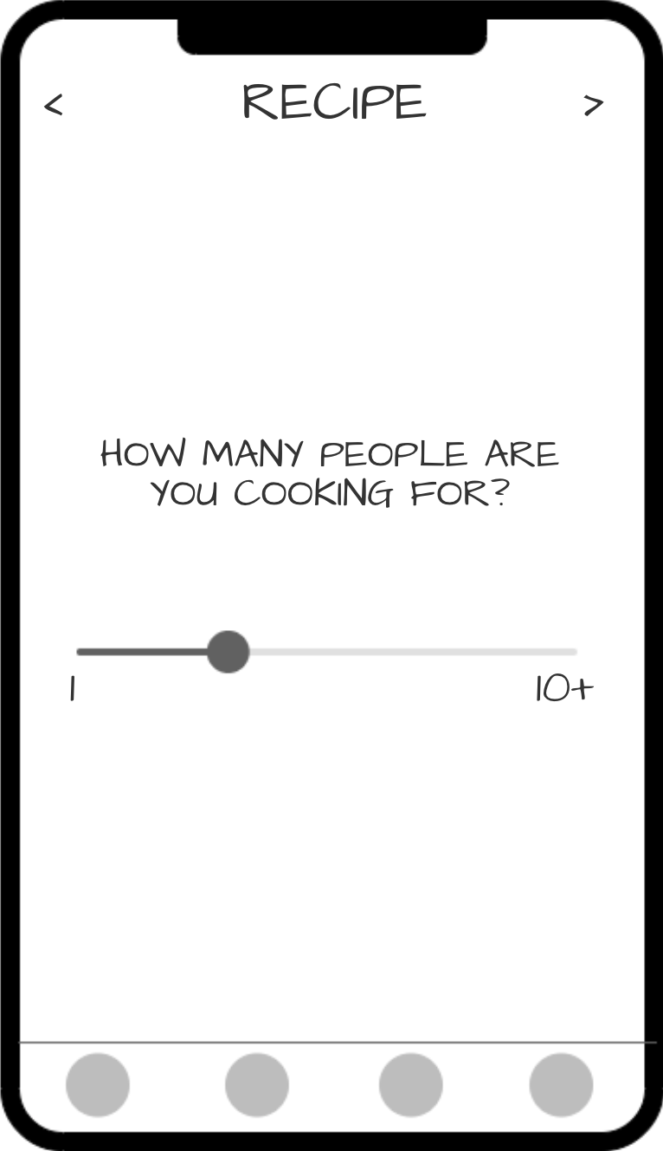
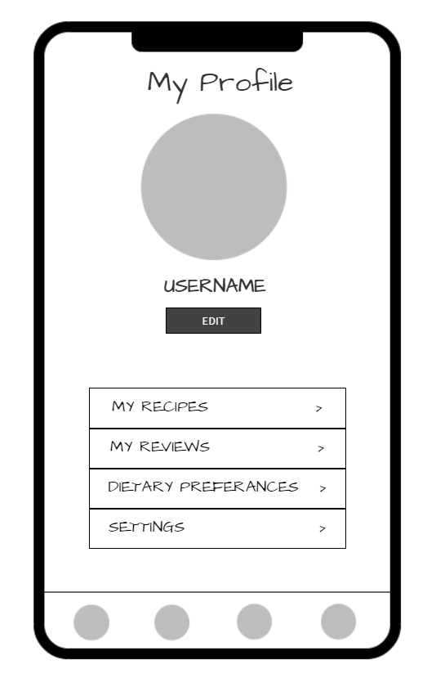
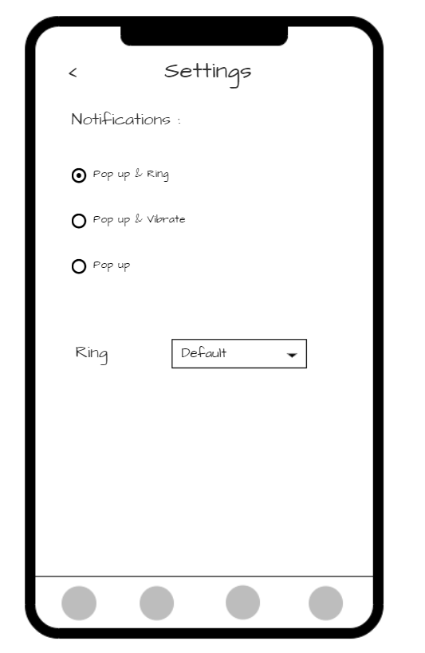

Slide 11
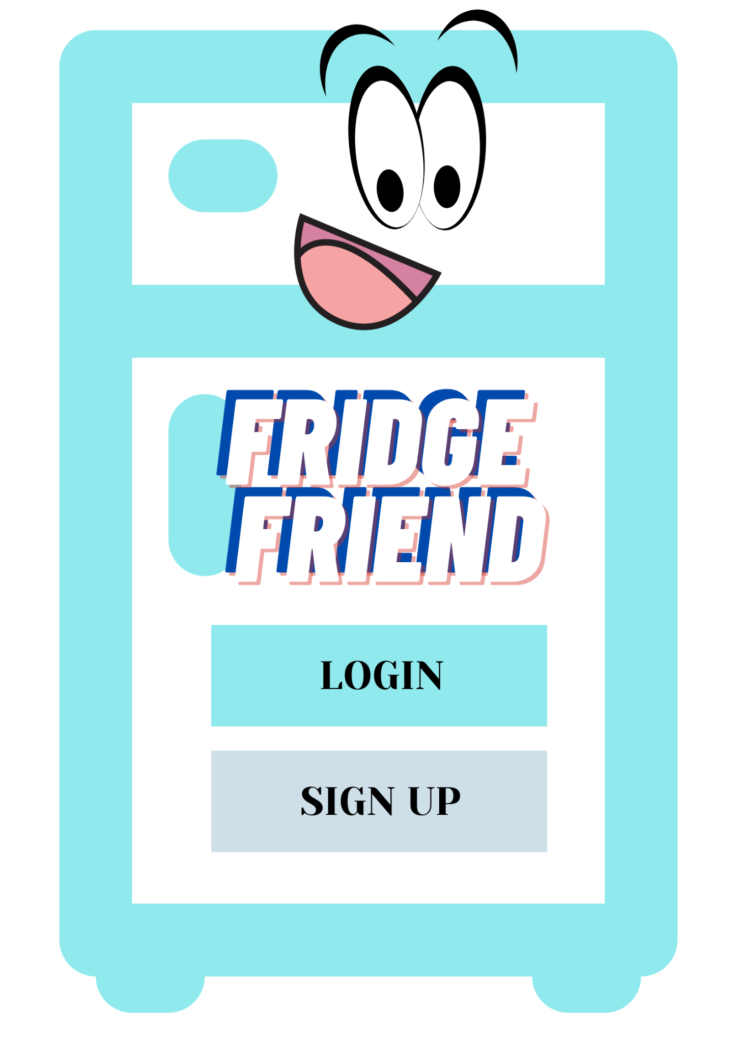
HIGH FIDELITY PROTOTYPE
This is the login page of our application.
Fridge Friend is an app that lets you check your fridge anywhere, anytime.
This page helps us keep track of the users and lets the user personalise their experience.

Slide 12
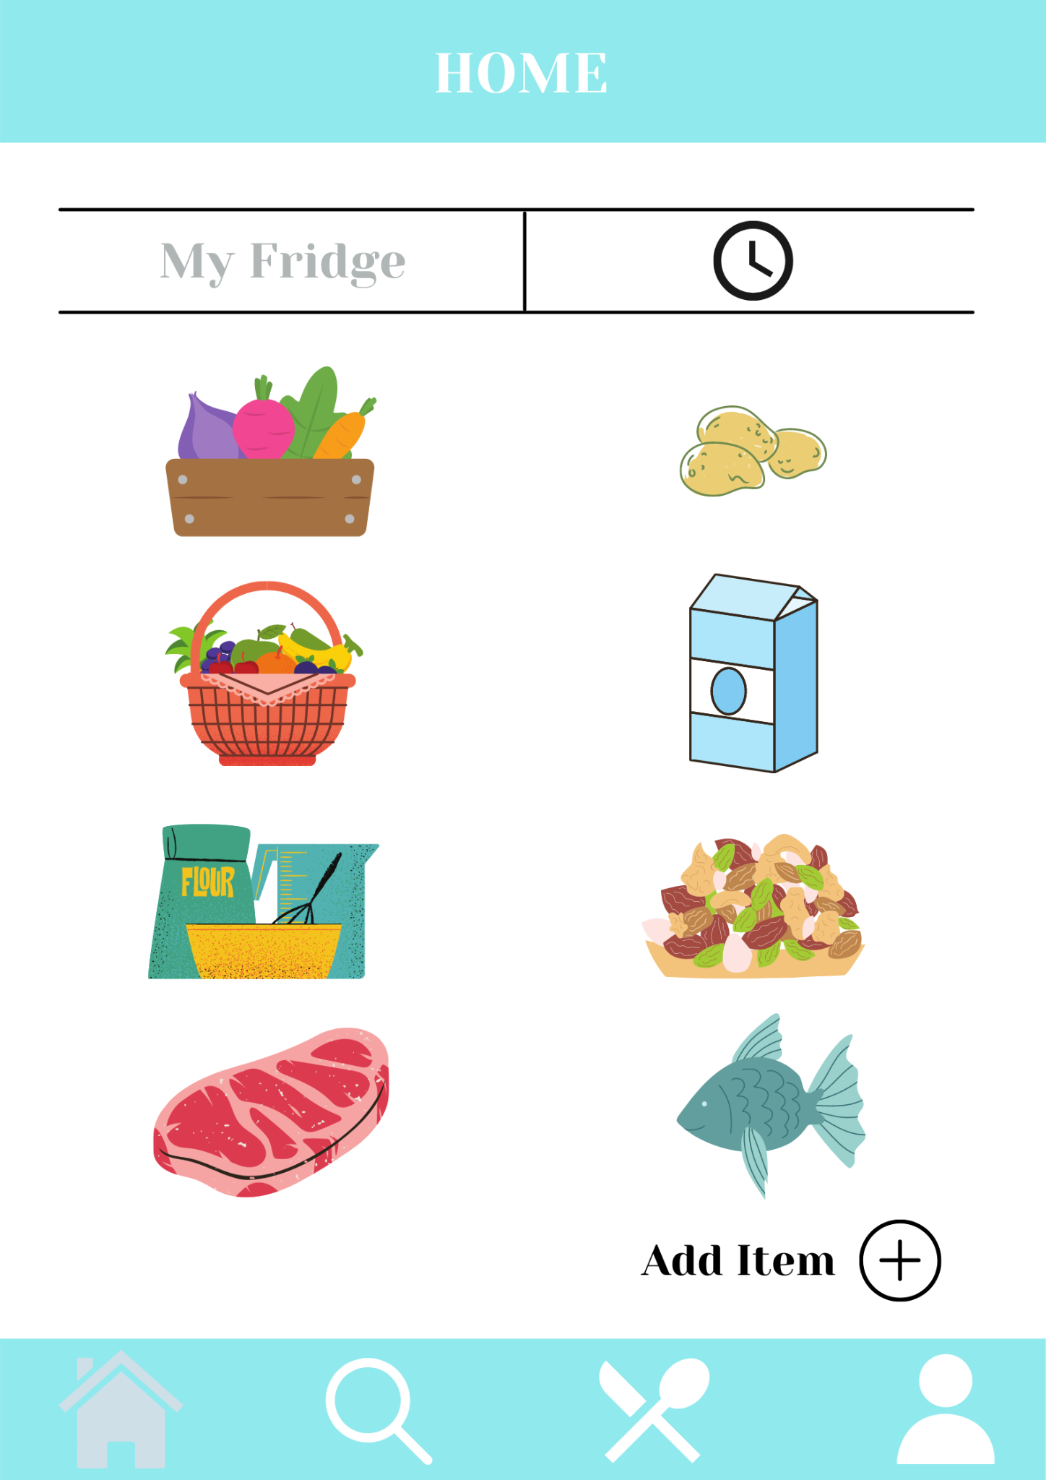
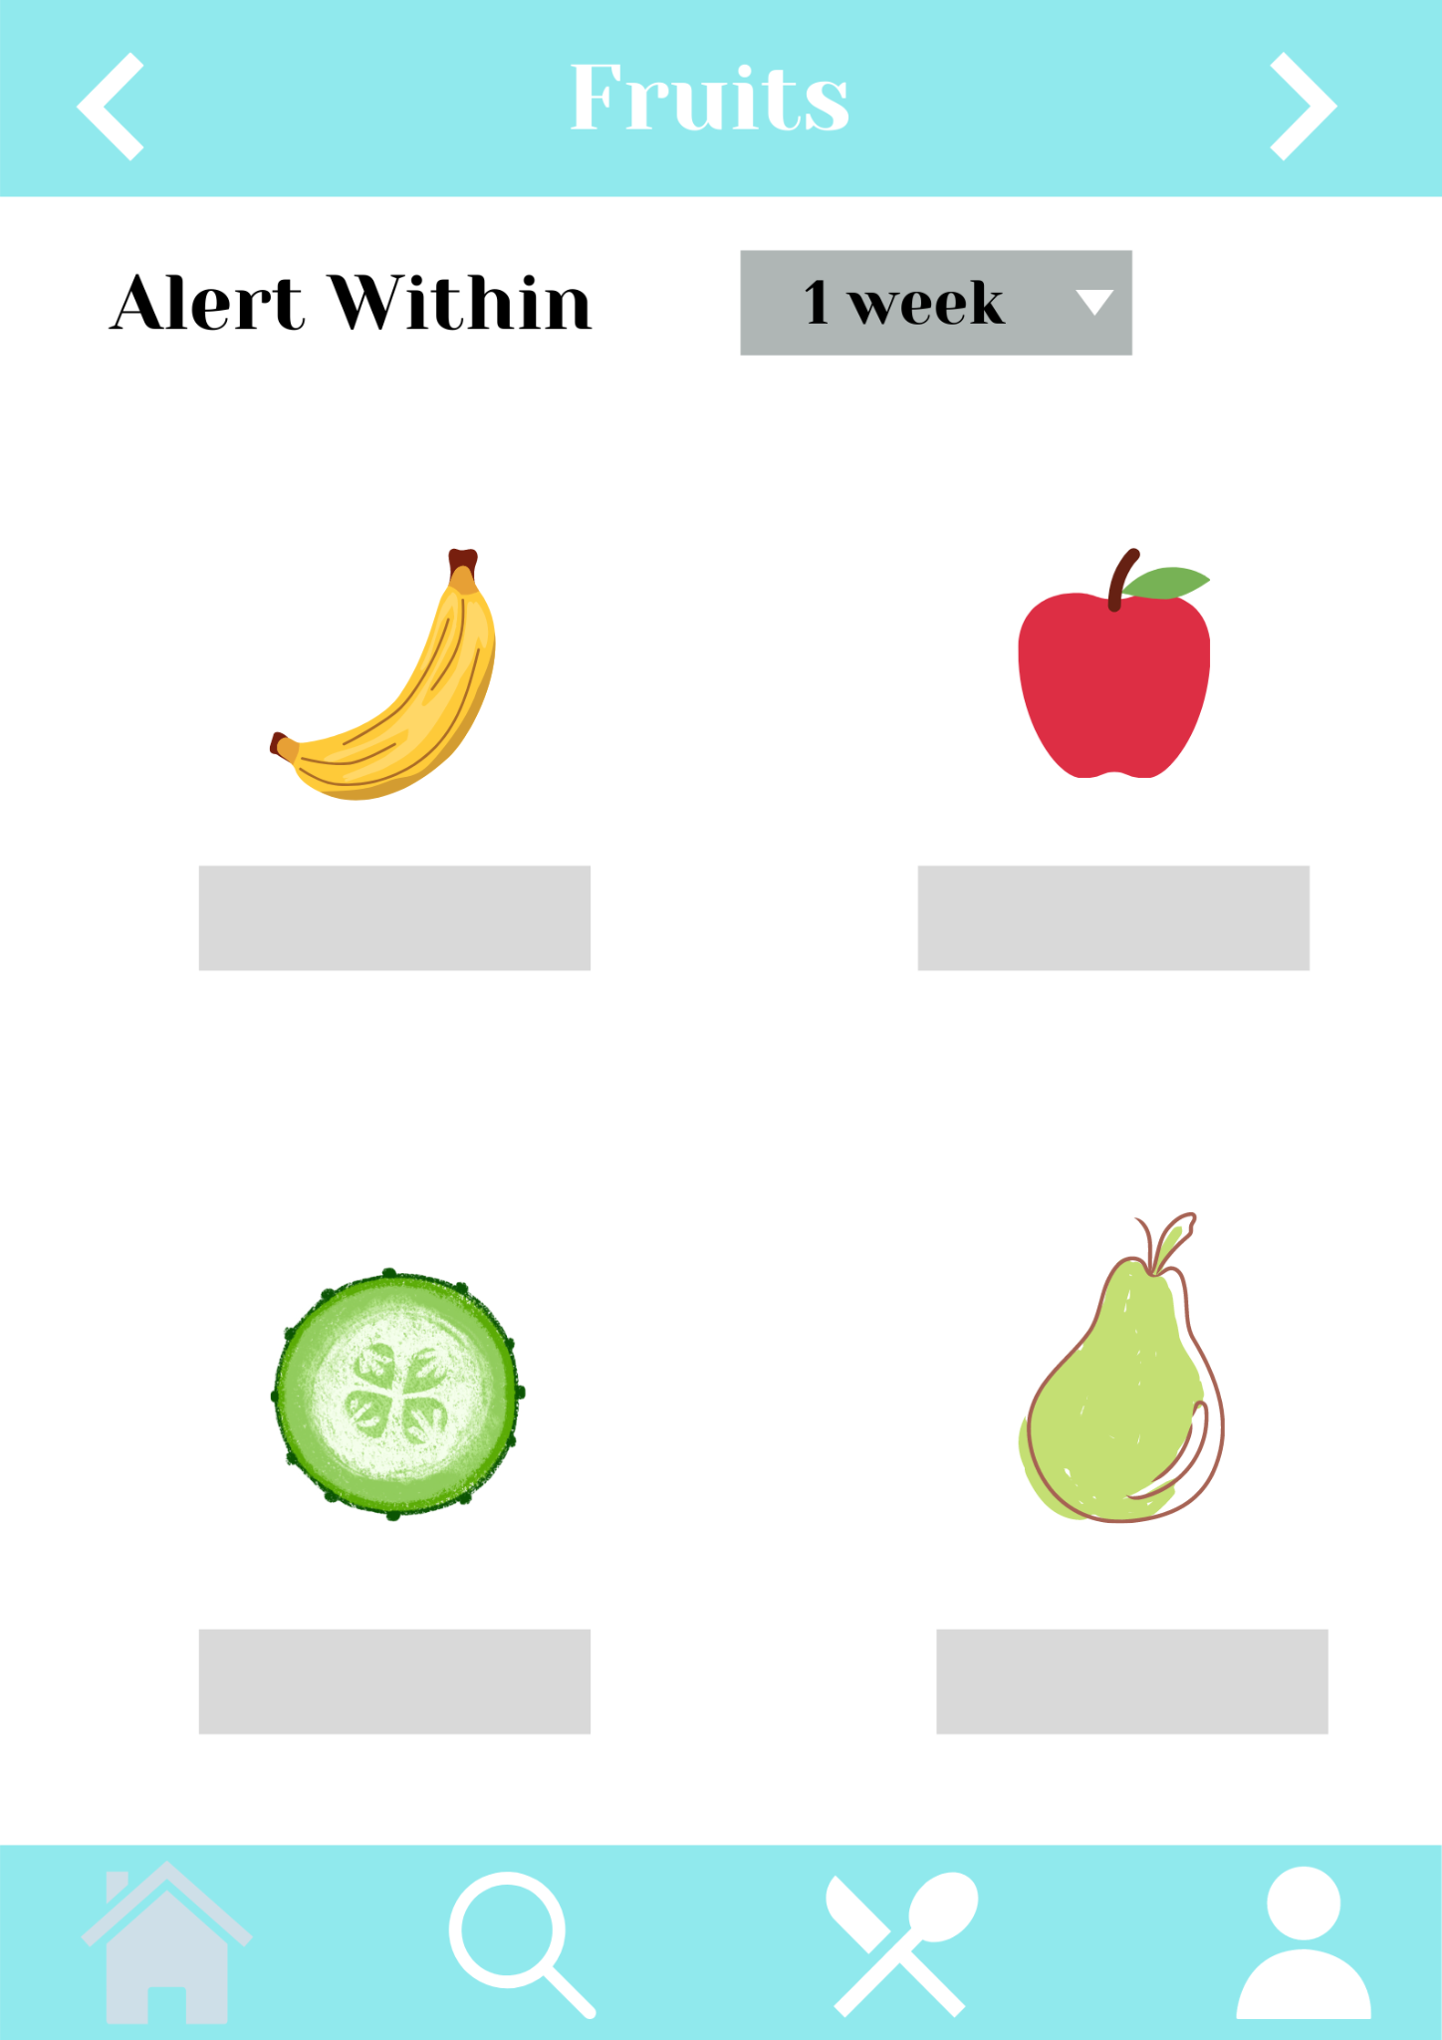
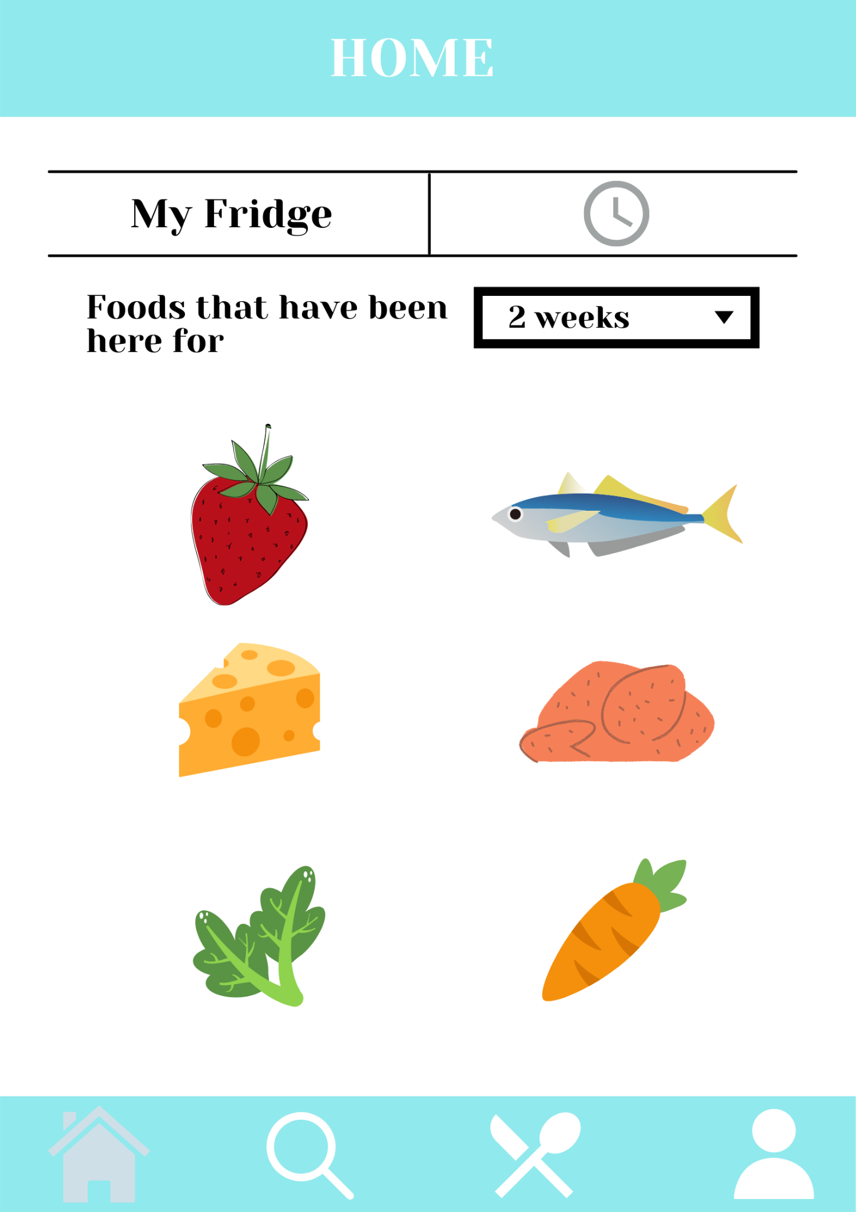
After the login, the user is directed to their home page, where they can have a overview of the items in their refrigerator. The user can track the freshness of their groceries and set an alert based on the category of food items, which is calculated from the date of the entry of the item in the inventory.

Slide 13
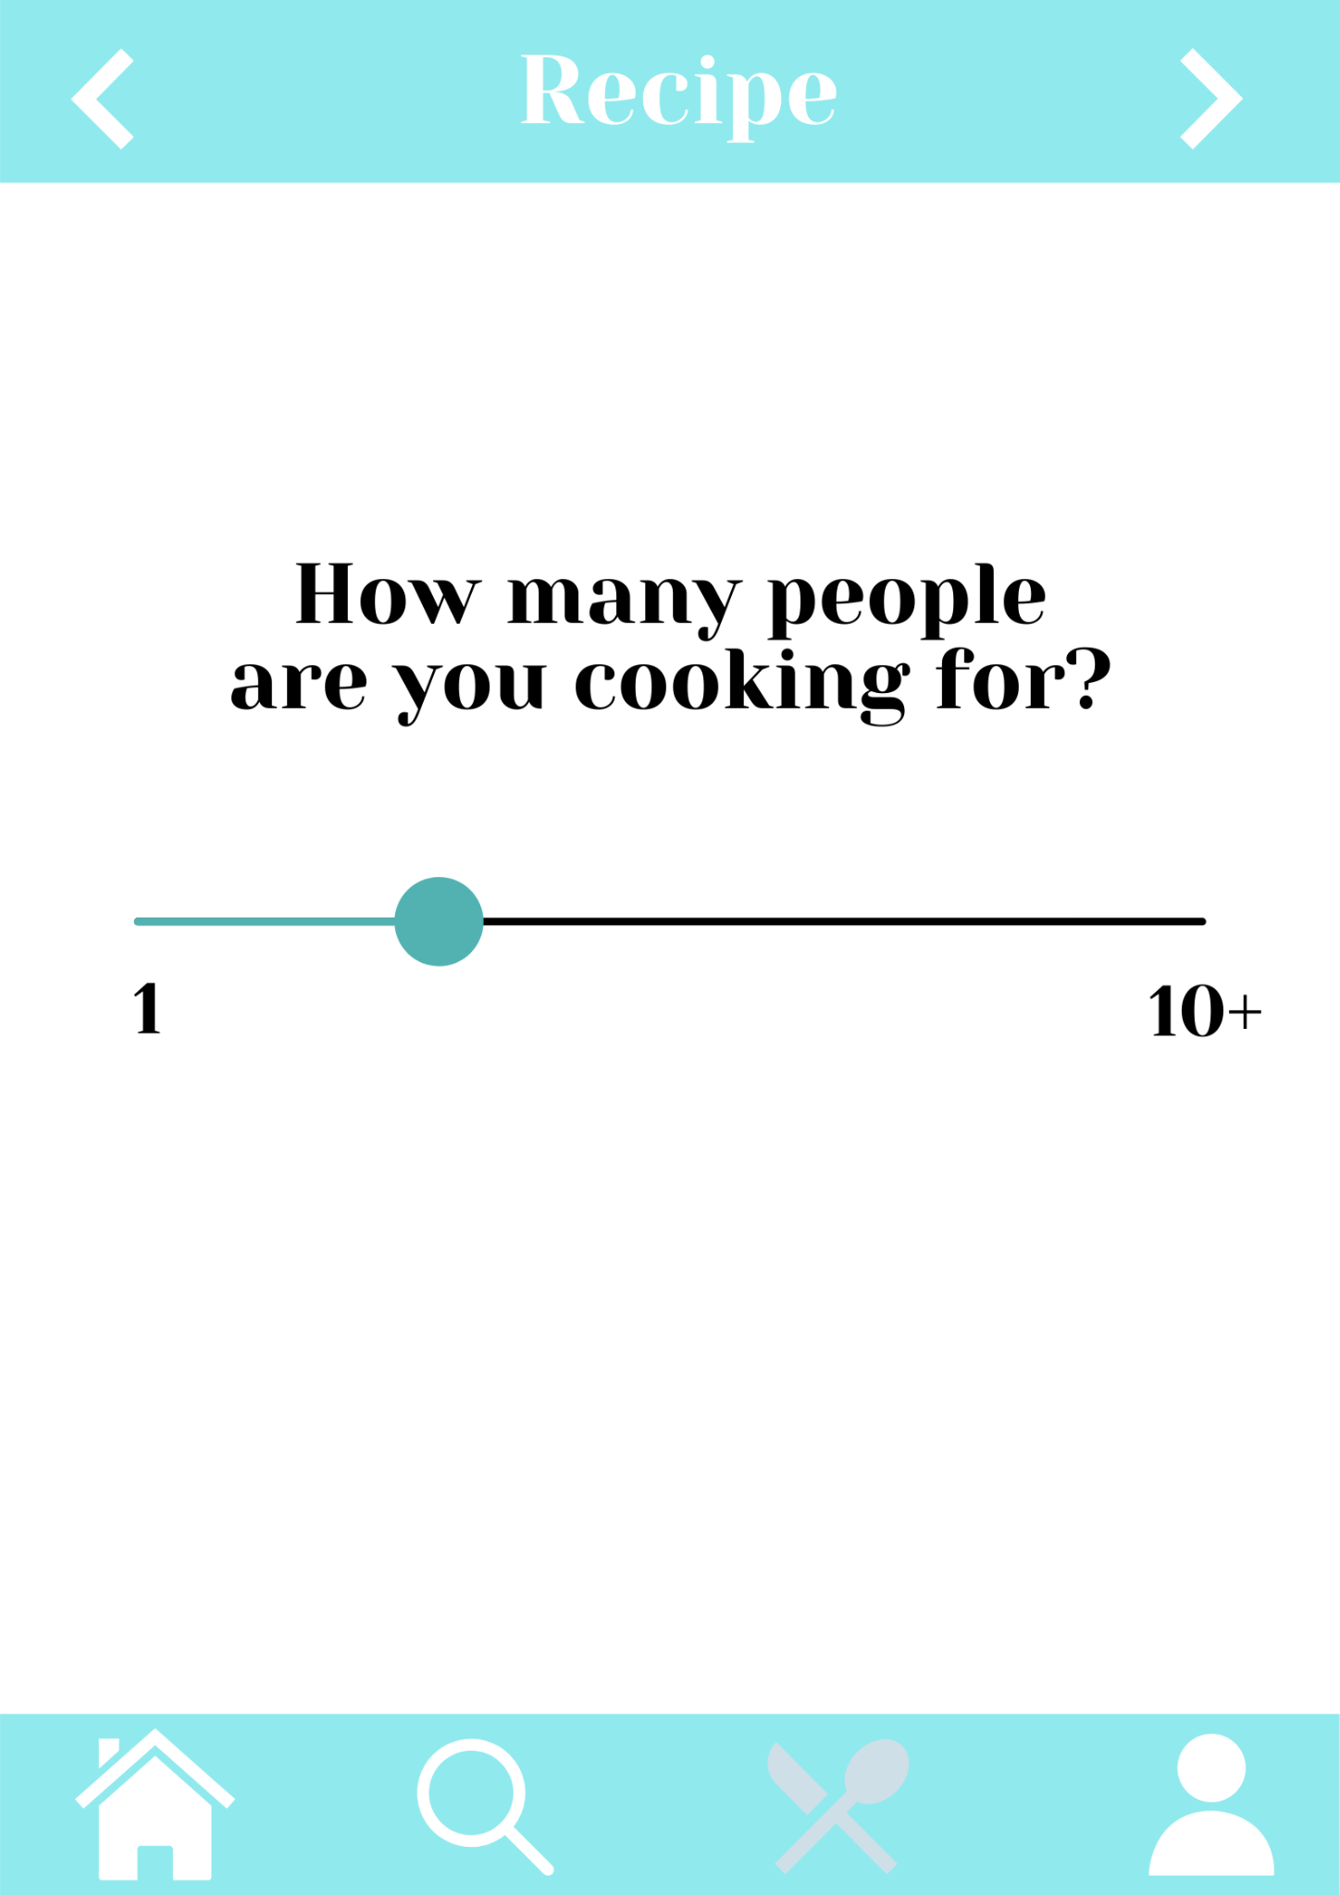
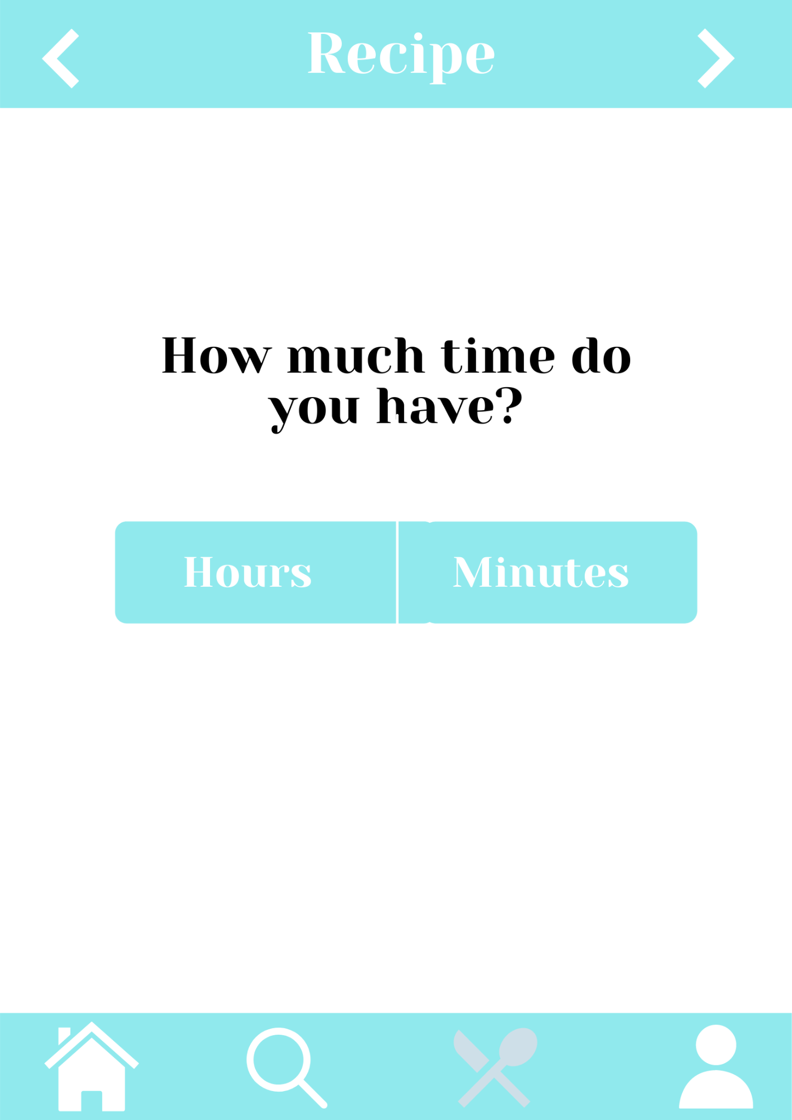
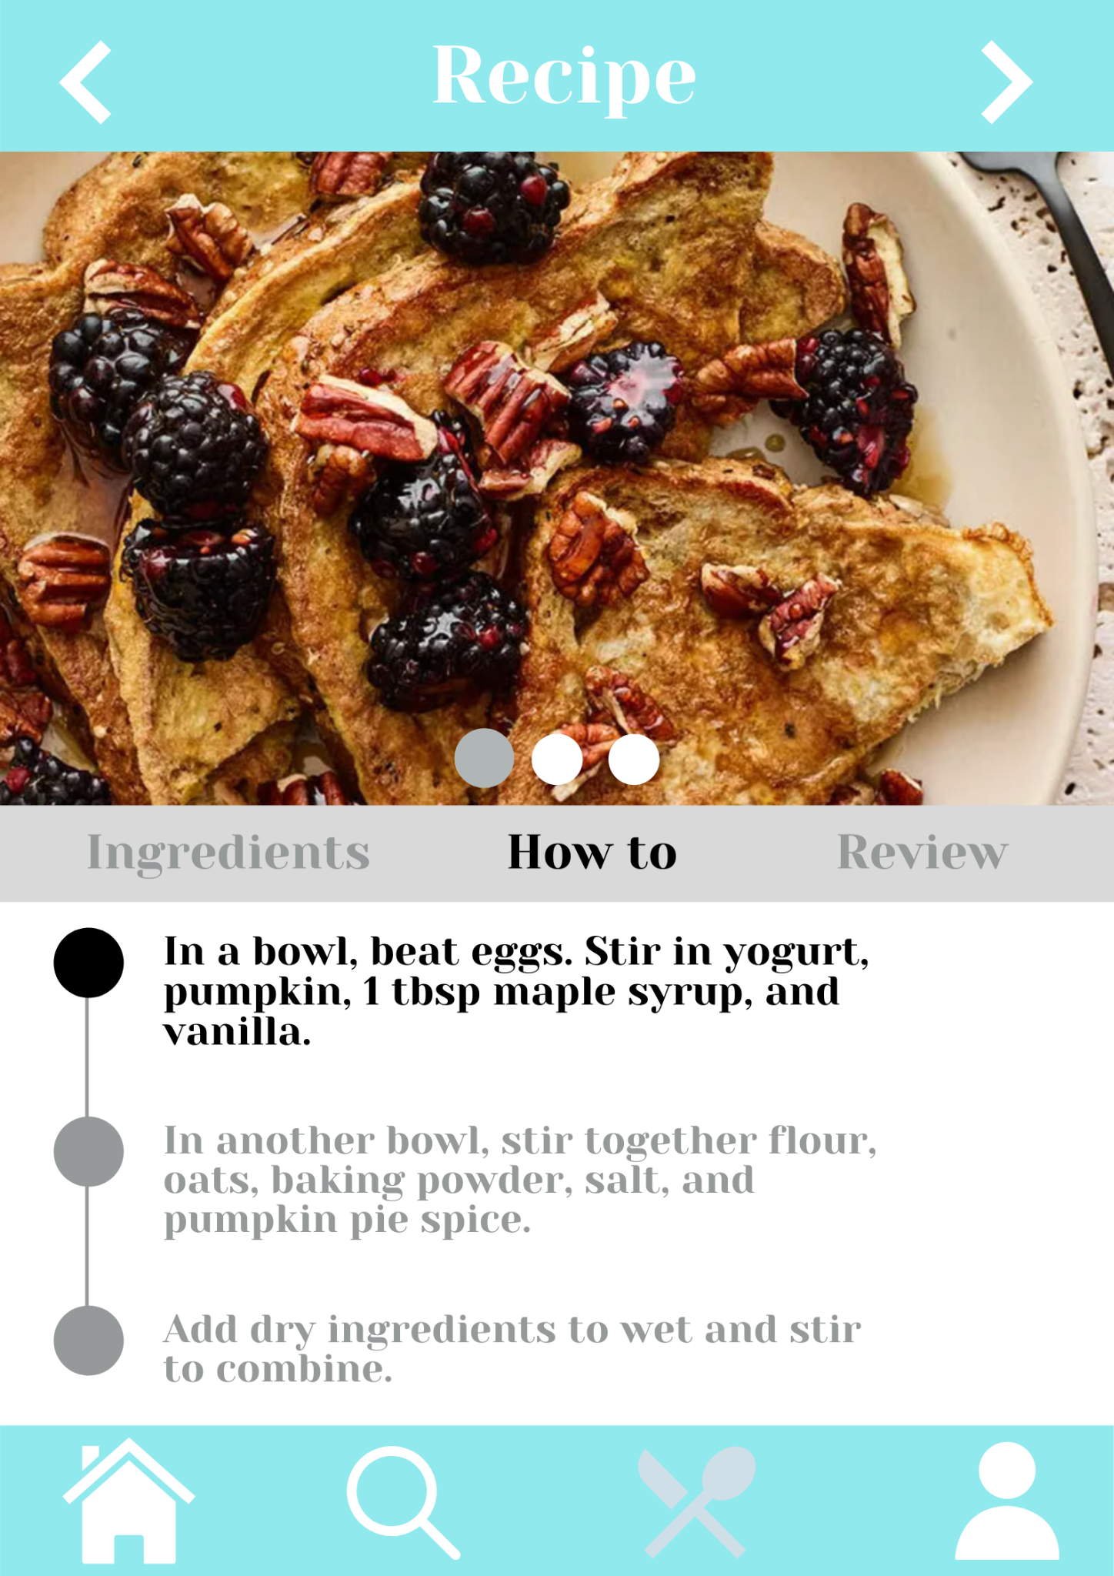
When alerted about an approaching expiry date, you can choose to search for a recipe involving the item. The app asks for the number of people eating and time you can spare to calculate the quantity of ingredients required and to make sure you don’t spend too much time in the kitchen. According to your dietary preference, the apps gives you recipe suggestions, step-by-step.

Slide 14
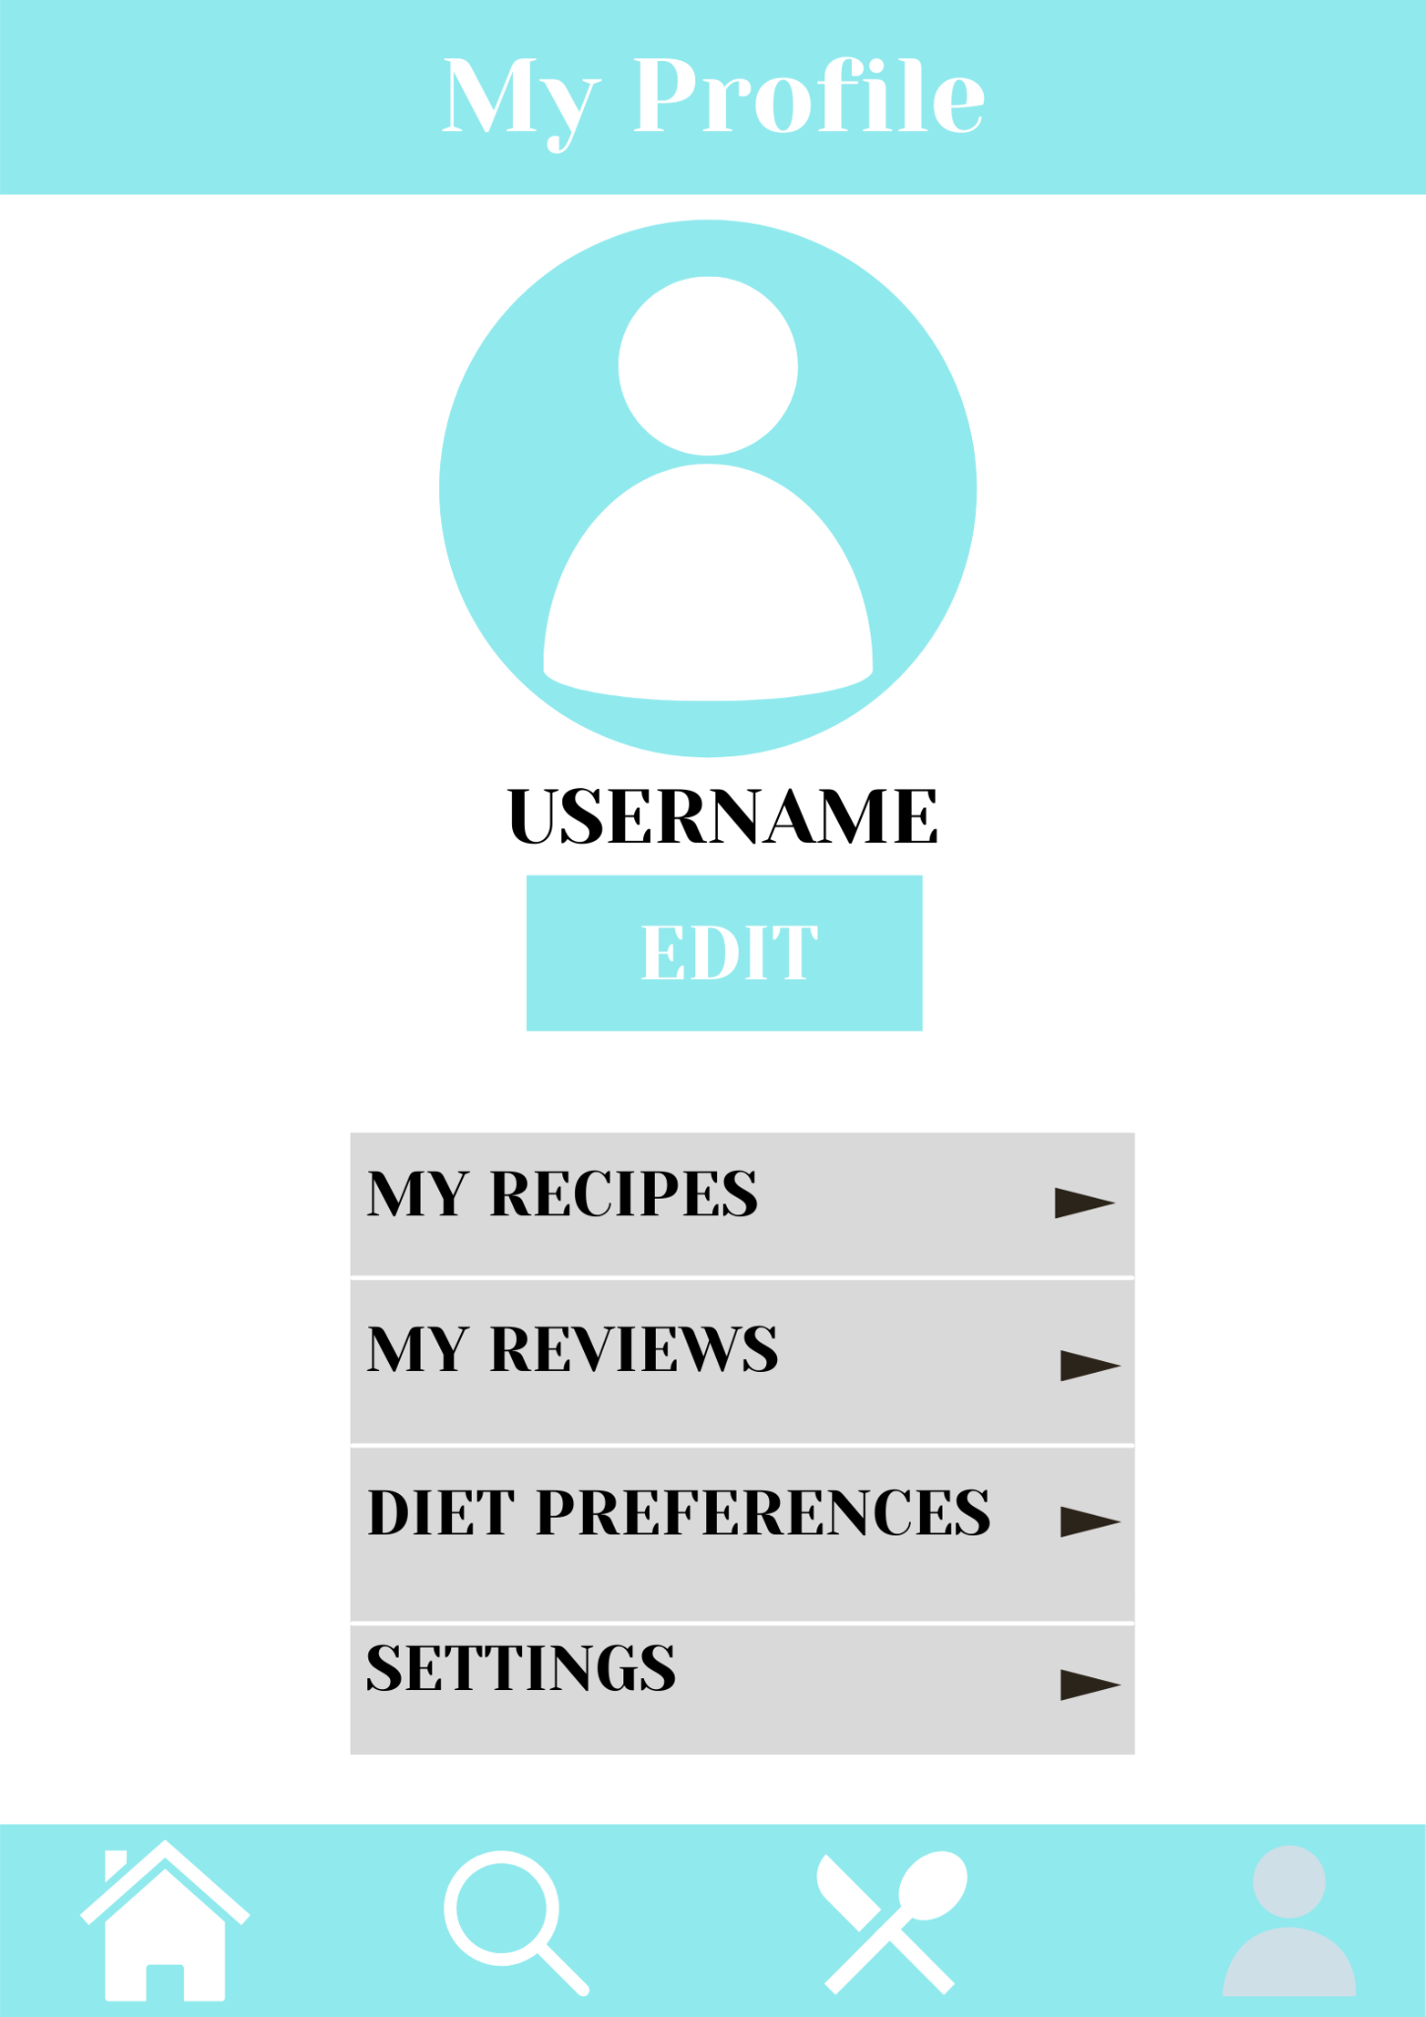
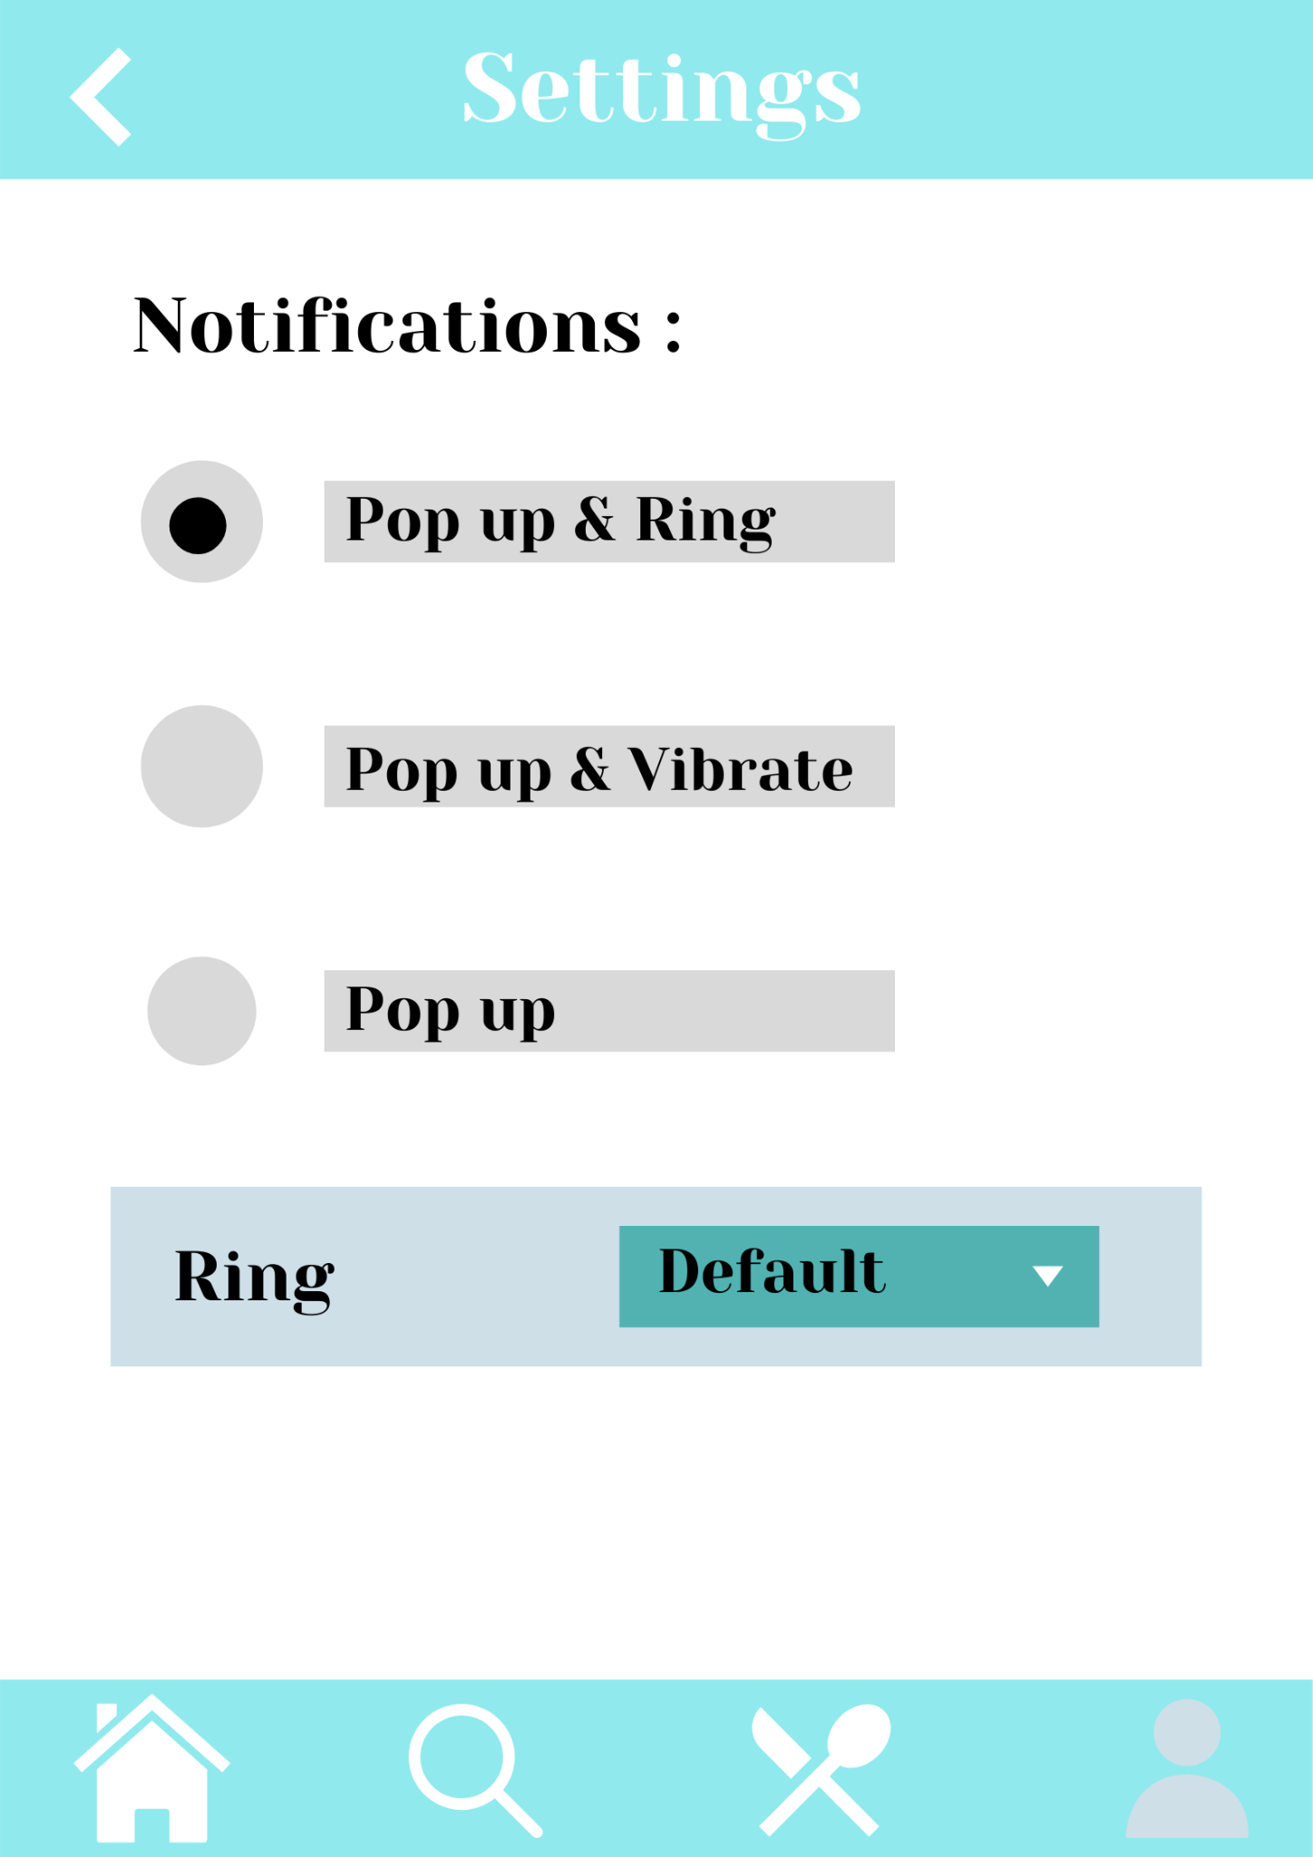
At the end, the user has his profile where we store their details, such as, their dietary preferences, the recipes they’ve used in the past and their reviews of the recipe.
The user can also configure their notification settings according to what suits them best.

Slide 15
Heuristic Evaluation
Visibility of System Status:
The mode the user is in is always displayed on
the top of the screen.
Three modes of notifications.
Vibration upon pressing the forward and back
navigate button.
Easy access to home, search, navigate and profile

Slide 16
2) Match between the system and real world
Easy to understand the terms and
types of food items.
The user can name the food
items thus making the names
exactly those that they use in
everyday life.

Slide 17
3) User Control and Freedom
User can easily navigate through the application using
the forward and back options.
They also are provided with the home,search,recipe
and profile options at the bottom of the screen to
easily navigate through the app.

Slide 18
4) Consistency and Standards:
All the screens follow the same format and layout.
The colour scheme of the background and buttons will also be
the same across all screens.

Slide 19
5) Aesthetic and minimalist design
Simple and minimalistic design.
Each screen Only represents the most important
functions.
Buttons are clearly visible and easy to identify.

Slide 20
6) Flexibility and efficiency of use
Simple and easy to understand layout, easy to use for a first time user as well as a frequent user.
Self-explanatory labels assigned to buttons

Slide 21
7) Recognition rather than recall
Consistent layout and design minimises the load on the users memory.
Self-Explanatory buttons and navigation option make it easy to use the app.

Slide 22
THANK YOU

